Slide 1
MY AUTOBIOGRAPHY

Slide 2
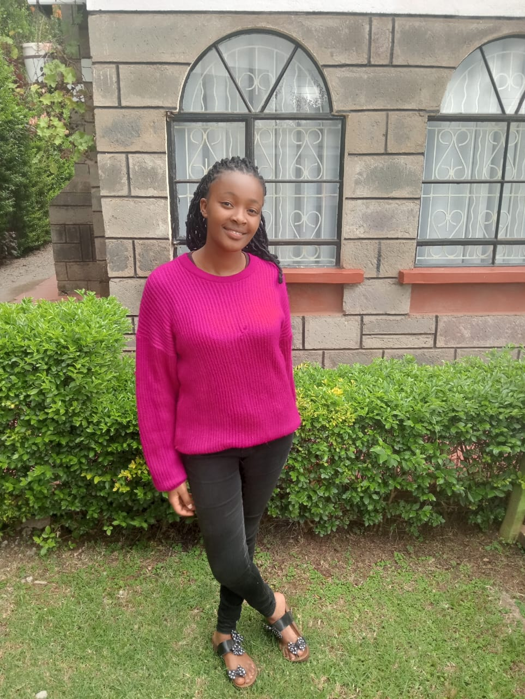
Introduction Content: -Introduction of Miriam Wairimu Maina -Birthdate and birthplace -Current residence and background

Slide 3
Family and Hometown From: Laikipia County, Kenya Family: Parents and siblings (Mercy Wanjira, Pauline Njoki, Cyrus Karugu) Parental Influence Content: Father: Joseph Githaiga (teacher, emphasis on discipline) Mother: Mary Githaiga (nurturing and supportive) Responsibilities and leadership as the eldest sibling

Slide 4
Village Life and Community: Childhood Adventures:
Close-knit village upbringing
Values of unity, togetherness, and community bonds
Bonding with cousins and childhood friends
Exploring the village, climbing trees, playing games
Shared camaraderie and friendships

Slide 5
Responsibilities and Chores
Helping parents with daily household tasksResponsibilities: fetching water, gardening, cooking, caring for animalsLearning early life skills and family contributions
Role as an older sibling: caring and guiding younger siblings
Strengthening family bonds through shared experiences
Lessons in patience, empathy, and leadership

Slide 6
Village Life's Simple Pleasures
-Storytelling, cultural festivals, and traditional celebrations
-Memorable experiences of holidays and community events
-Appreciation for heritage and village life

Slide 7
Reflection and Conclusion
Reflection on childhood innocence and values learned
Impact of family, friends, and community on personal growth
Lessons carried forward into adulthood and future aspirations

Slide 8
Introduction to Catholic Faith
Early exposure to Catholic rituals and teachings
Influence of parents in spiritual upbringing
Values of compassion, integrity, and perseverance instilled from childhood

Slide 9
Baptism and Confirmation -Eagerness for baptism and sense of community -Memorable experience of baptism at age 9 -Confirmation at age 12 as a deeper commitment to faith

Slide 10
EDUCATION AND GROWTH - Education Journey

Slide 11
Early Education: Started schooling at Mranatha Juniors School at age three, showing early signs of leadership and enthusiasm for learning. Primary Education: Attended Queen Esther Primary School, excelling academically and becoming involved in leadership roles and extracurricular activities. Transition to Secondary School: Transitioned to Naivasha Girls High School, achieving academic success and participating actively in competitions and clubs.

Slide 12
Leadership and Academic Achievements Leadership Roles: From class prefect to various leadership positions, developing organizational and communication skills. Academic Excellence: Consistent academic success, particularly in mathematics, participation in contests, and recognition through awards and accolades. . Extracurricular Adventures Musical Pursuits: Involvement in the school choir, discovering a passion for music and teamwork through performances and competitions. Sports: Participation in volleyball, learning values of teamwork, communication, and perseverance on the court.

Slide 13
Community Involvement Outreach Programs: Active engagement in community service initiatives such as tree-planting and mentorship programs, emphasizing the importance of compassion and altruism. Impact of Service: Reflections on how community involvement shaped personal values and contributed to making a difference in the lives of others. Cultural Appreciation Rich Cultural Heritage: Immersion in Kenya's diverse cultural festivals, celebrating traditions and fostering unity through cultural appreciation. Personal Insights: Lessons learned about the significance of cultural identity and the power of embracing diversity.

Slide 14
Achievements and Awards Recognition: Highlighting various awards received for academic achievements, leadership skills, and contributions to the school and community. Motivation and Future Goals: How achievements fueled motivation for future aspirations and goals in education and beyond.

Slide 15
University Journey Transition to Dedan Kimathi University of Technology Started in 2021: Pursuing Bachelor of Business Information Technology Formative experience in education and personal growth

Slide 16
Expertise and Skills Proficient in Python, Java, Kotlin Experience in NLP, Computer Vision, Machine Learning Skilled in data analysis and visualization

Slide 17
Professional Experience and Goals Projects and Hackathons Developed a recipe app with deep learning Conducted sentiment analysis using NLP Created disease detection model with CNNs

Slide 18
Love for the Outdoors Avid hiker and mountain climber Climbed Mount Kenya twice Explored Mount Longonot, Mount Oldonyo Sabuk, and Aberdare Ranges

Slide 19
Community Involvement and Career Goals -Active in DSAIC club and community service -Aspiring to bridge technology and business Eager to make a positive impact through career and service

Slide 20
Conclusion Reflection: Reflecting on the transformative journey of growth, learning, and self-discovery through primary and secondary education in Kenya. Gratitude: Acknowledging the support of family, teachers, and peers in shaping personal and academic development. Looking Ahead: Anticipation and readiness for future endeavors, carrying forward lessons and values learned during formative years.

Slide 21
THANK YOU

